Slide 1
Autoencoders
Shangsong Liang
Sun Yat-sen University
Originally produced byGuy Golan

Slide 2
Agenda
- Unsupervised Learning (Introduction)
- Autoencoder (AE)
- Convolutional AE
- Regularization: Sparse
- Denoising AE
- Stacked AE
- Contractive AE

Slide 3
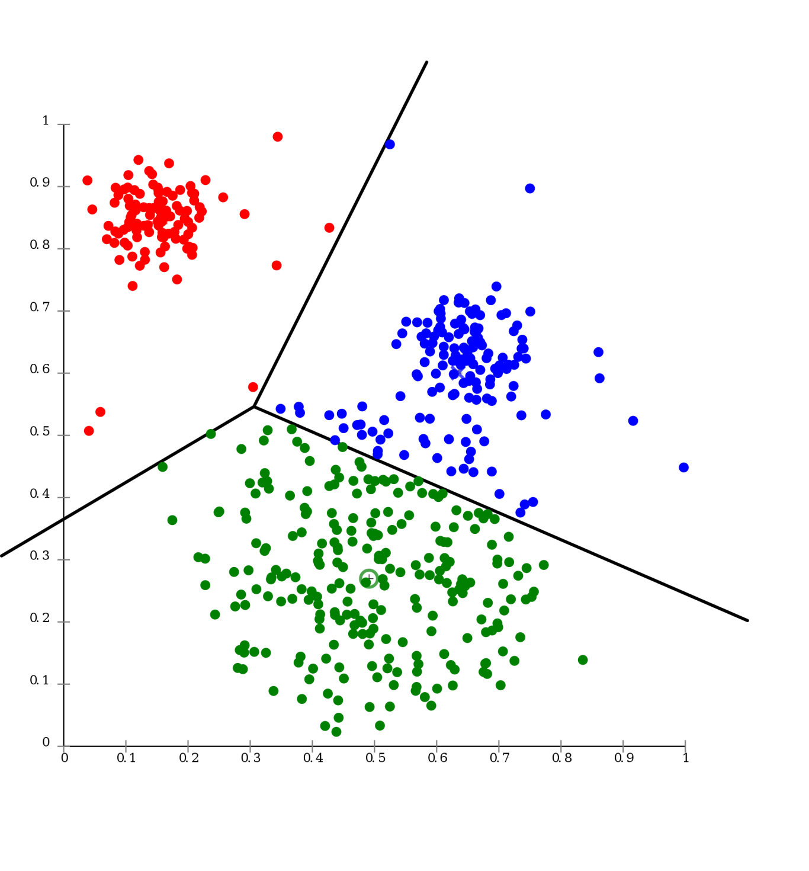
Introduction to Unsupervised Learning

Slide 4

Supervised Learning
Supervised Learning
Data: (X,Y)
Goal: Learn a Mapping Function f where:
f(X) = Y

Slide 5
Supervised Learning
X2
Examples: Classification.
Decision Trees
Naïve Bayes
KNN
SVM
Perceptron
Multi Layer Perceptron
X1
Classification

Slide 6
Supervised Learning
Examples: Regression.
X2
Linear Regression
Logistic Regression
X1
Regression

Slide 7
Supervised Learning vs Unsupervised Learning
What happens when our labels are noisy?
01
Missing values.
Labeled incorrectly.
What happens where we don’t have labels for training at all?
02

Slide 8
Supervised Learning vs Unsupervised Learning
Up until now we have encountered mostly Supervised Learning problems and algorithms.
Lets talk about Unsupervised Learning

Slide 9
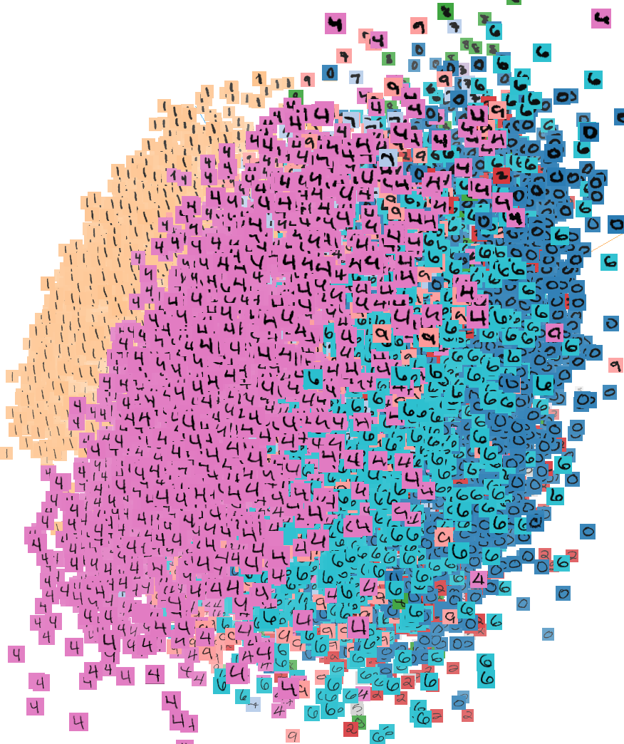
Unsupervised Learning
Unsupervised Learning
Data: X (no labels!)
Goal: Learn the structure of the data (learn correlations between features)

Slide 10
Unsupervised Learning
Examples: Clustering, Compression, Feature & Representation learning, Dimensionality reduction, Generative models ,etc.

Slide 11
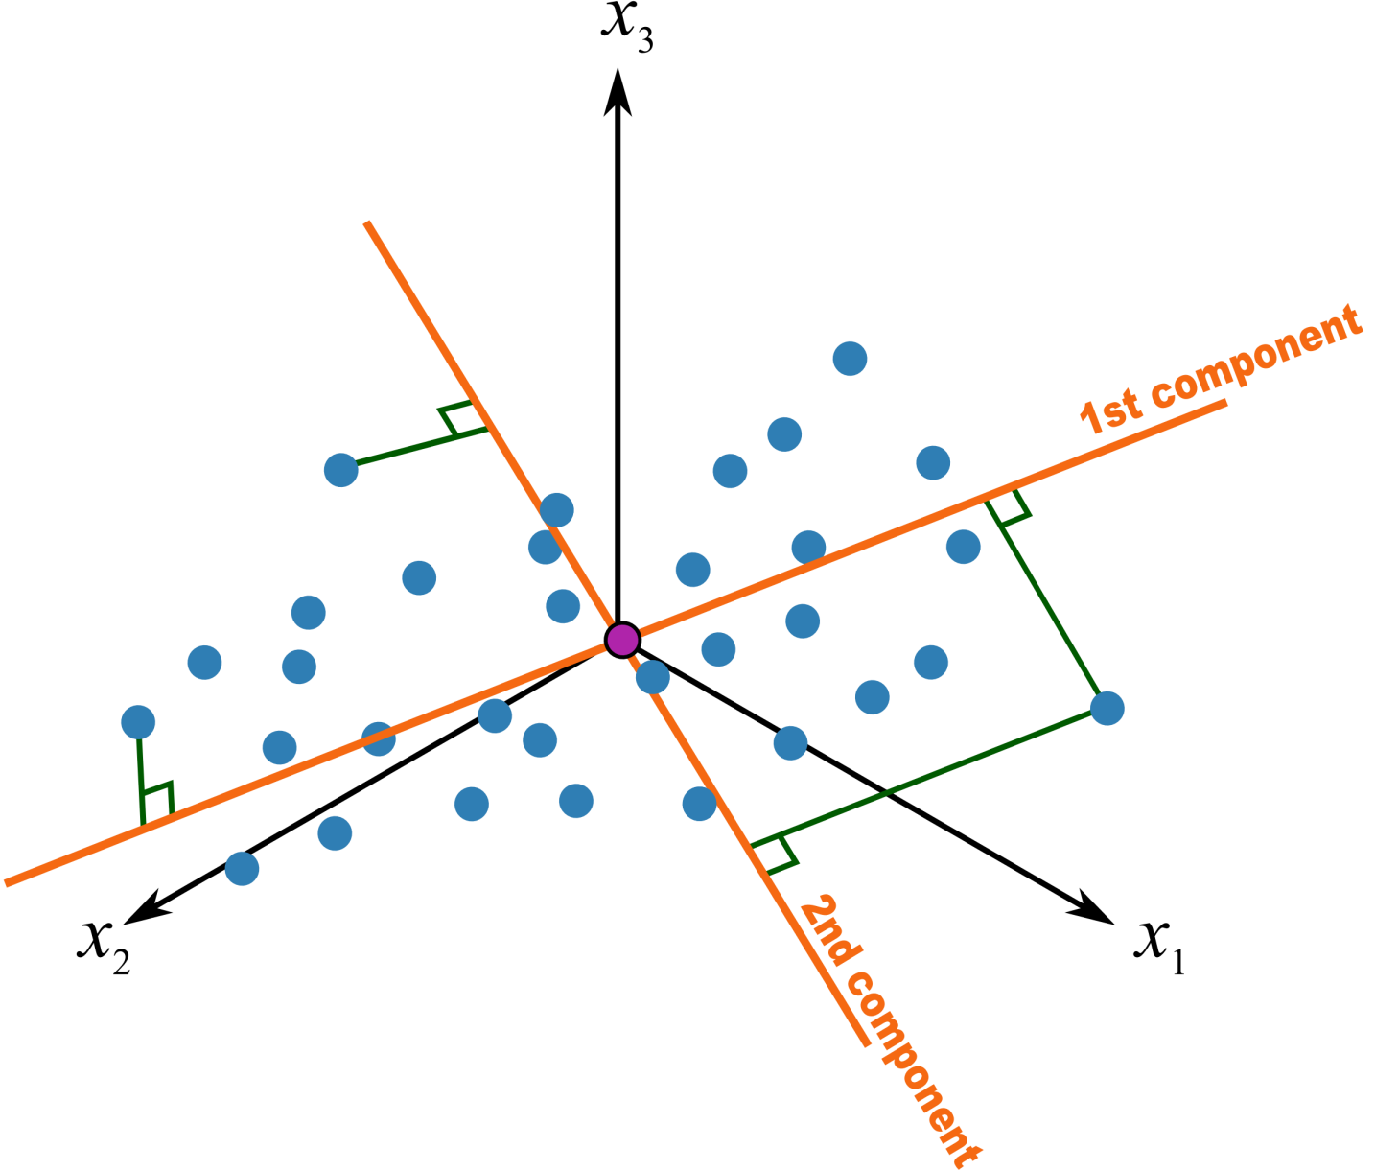
PCA – Principal Component analysis
Statistical approach for data compression and visualization
Invented by Karl Pearson in 1901
Weakness: linear components only.

Slide 12
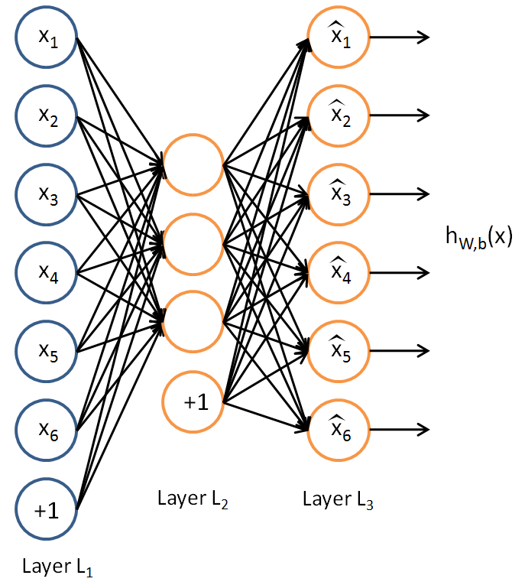
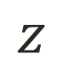
Traditional Autoencoder
$$z$$

Slide 13
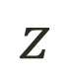
Traditional Autoencoder
Unlike the PCA now we can use activation functions to achieve non-linearity.
It has been shown that an AE without activation functions achieves the PCA capacity.
$$z$$

Slide 14
Uses
The autoencoder idea was a part of NN history for decades (LeCun et al, 1987).
Traditionally an autoencoder is used for dimensionality reduction and feature learning.
Recently, the connection between autoencoders and latent space modeling has brought autoencoders to the front of generative modeling.
Not used for compression.
-Data specific compression.
-Lossy.

Slide 15
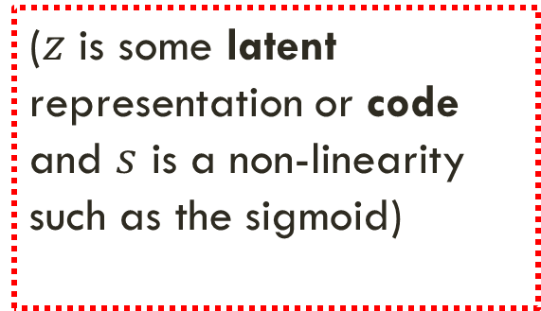
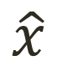
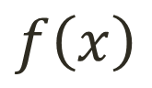
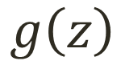
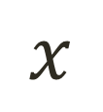
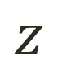
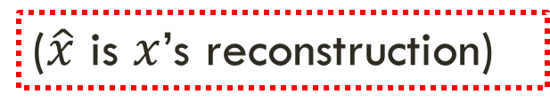
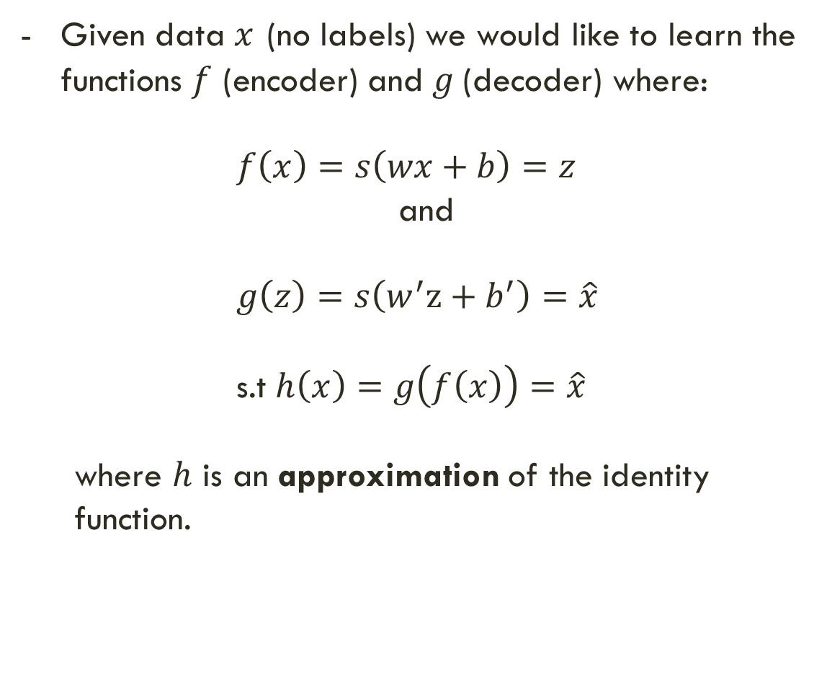
Simple Idea
$$x$$
$$f\left(x\right)$$
$$z$$
$$g\left(z\right)$$
$$\hat{x}$$
Given data $x$ (no labels) we would like to learn the functions $f$ (encoder) and $g$(decoder) where:
$f\left(x\right)=s\left(wx+b\right)=z$
and
$g\left(z\right)=s\left(w^{′}z+b^{′}\right)=\hat{x}$
s.t $h\left(x\right)=g\left(f\left(x\right)\right)=\hat{x}$
where $h$ is an approximation of the identity function.
($z$ is some latent representation or code and $s$ is a non-linearity such as the sigmoid)
($\hat{x}$ is $x$’s reconstruction)

Slide 16
Simple Idea
Learning the identity function seems trivial, but with added constraints on the network (such as limiting the number of hidden neurons or regularization) we can learn information about the structure of the data.
Trying to capture the distribution of the data (data specific!)

Slide 17
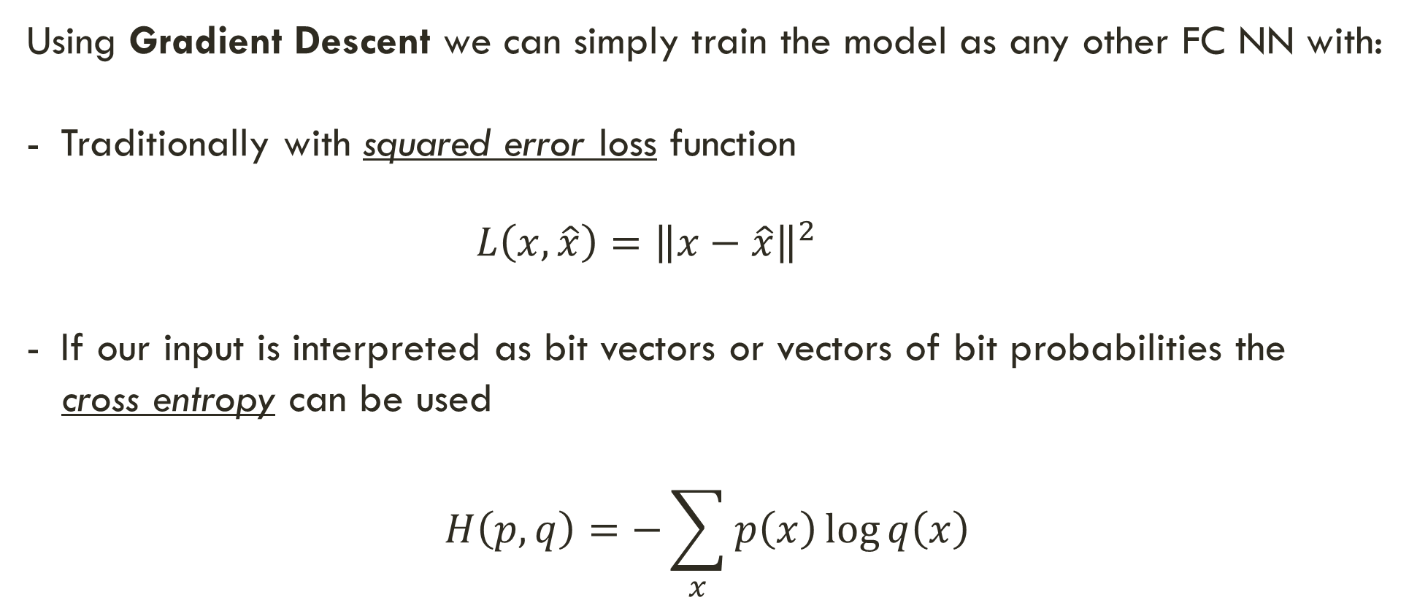
Training the AE
Using Gradient Descent we can simply train the model as any other FC NN with:
Traditionally with squared error loss function
$L\left(x,\hat{x}\right)={\left\|x−\hat{x}\right\|}^{2}$
If our input is interpreted as bit vectors or vectors of bit probabilities the
cross entropy can be used
$$H\left(p,q\right)=−\sum_{x}{p\left(x\right)\log{q\left(x\right)}}$$

Slide 18
Undercomplete AE VS overcomplete AE
We distinguish between two types of AE structures:

Slide 19
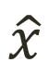

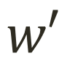
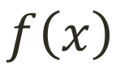
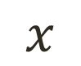
Undercomplete AE
Hidden layer is Undercomplete if smaller than the input layer
Compresses the input
Compresses well only for the training dist.
$$\hat{x}$$
$$w′$$
$$f\left(x\right)$$
Hidden nodes will be
Good features for the training distribution.
Bad for other types on input
$$w$$
$$x$$

Slide 20
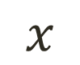
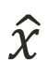


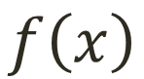
Overcomplete AE
Hidden layer is Overcomplete if greater than the input layer
No compression in hidden layer.
Each hidden unit could copy a different input component.
$$\hat{x}$$
$$w′$$
$$f\left(x\right)$$
No guarantee that the hidden units will extract meaningful structure.
$$w$$
Adding dimensions is good for training a linear classifier (XOR case example).
A higher dimension code helps model a more complex distribution.
$$x$$

Slide 21
Deep Autoencoder Example
https://cs.stanford.edu/people/karpathy/convnetjs/demo/autoencoder.html - By Andrej Karpathy

Slide 22

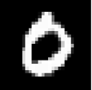

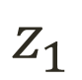
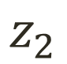
Simple latent space interpolation - keras
$$z_{1}$$
Encoder
$$z_{2}$$
Encoder

Slide 23

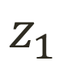
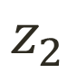
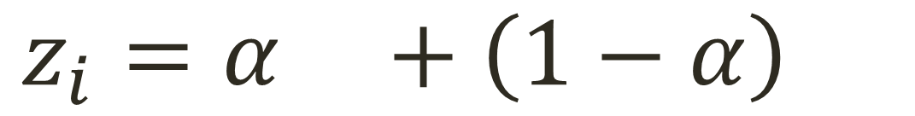
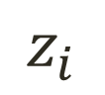
Simple latent space interpolation - keras
$$z_{1}$$
$$z_{2}$$
$$z_{i}=α +\left(1−α\right)$$
$$z_{i}$$
Decoder

Slide 24
Simple latent space interpolation – keras code example

Slide 25
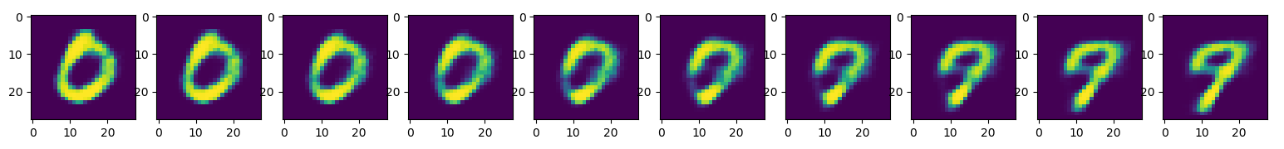
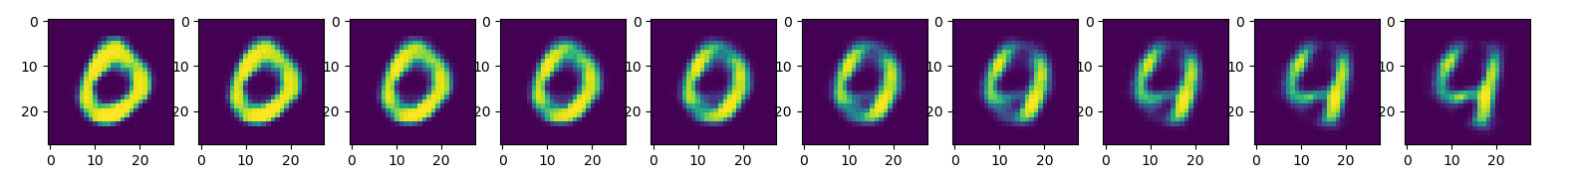
Simple latent space – interpolation - keras

Slide 26
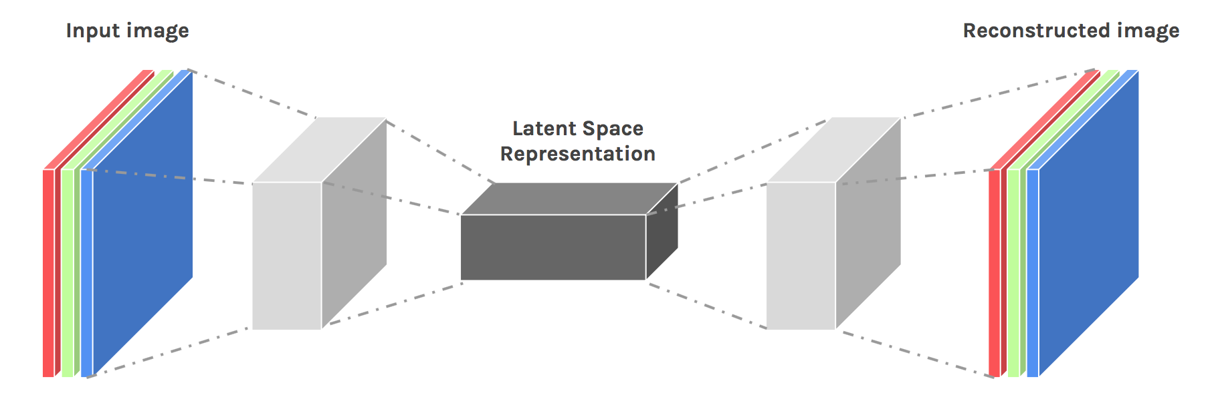
Convolutional AE

Slide 27
Convolutional AE
* Input values are normalized
* All of the conv layers activation functions are relu except for the last conv which is sigm
Output
Input
(28,28,1)
C1
(28,28,16)
M.P1
(14,14,16)
C2
(14,14,8)
M.P2
(7,7,8)
C3
(7,7,8)
M.P3
(4,4,8)
D.C1
(4,4,8)
U.S1
(8,8,8)
D.C2
(8,8,8)
U.S2
(16,16,8)
D.C3
(14,14,16)
U.S3
(28,28,8)
D.C4
(28,28,1)
Conv 1
16 F
@ (3,3,1)
same
M.P 1
(2,2)
same
Conv 2
8 F
@ (3,3,16)
same
M.P 2
(2,2)
same
Conv 3
8 F
@ (3,3,8)
same
M.P 3
(2,2)
same
D Conv 1
8 F
@ (3,3,8)
same
U.S 1
(2,2)
D Conv 2
8 F
@ (3,3,8)
same
U.S 2
(2,2)
D Conv 3
16 F
@ (3,3,8)
valid
U.S 3
(2,2)
D Conv 4
1 F
@ (5,5,8)
same
Hidden Code
Encoder
Decoder

Slide 28
Convolutional AE – Keras example

Slide 29
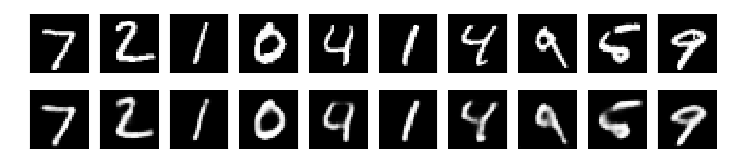
Convolutional AE – Keras example results
- 50 epochs.
- 88% accuracy on validation set.

Slide 30
Regularization
Motivation:
We would like to learn meaningful features without altering the code’s dimensions (Overcomplete or Undercomplete).
The solution: imposing other constraints on the network.

Slide 31
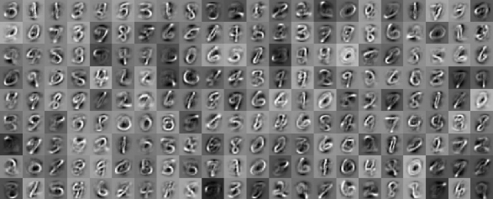
Sparsely Regulated Autoencoders
Activation Maps
A bad example:

Slide 32
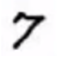
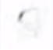
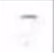
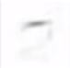
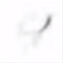
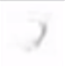
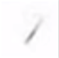
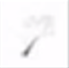

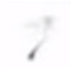
Sparsely Regulated Autoencoders
We want our learned features to be as sparse as possible.
With sparse features we can generalize better.
= 1*
+ 1*
+ 1*
+ 1*
+ 1*
+ 1*
+ 1*
+ 0.8*
+ 0.8*

Slide 33
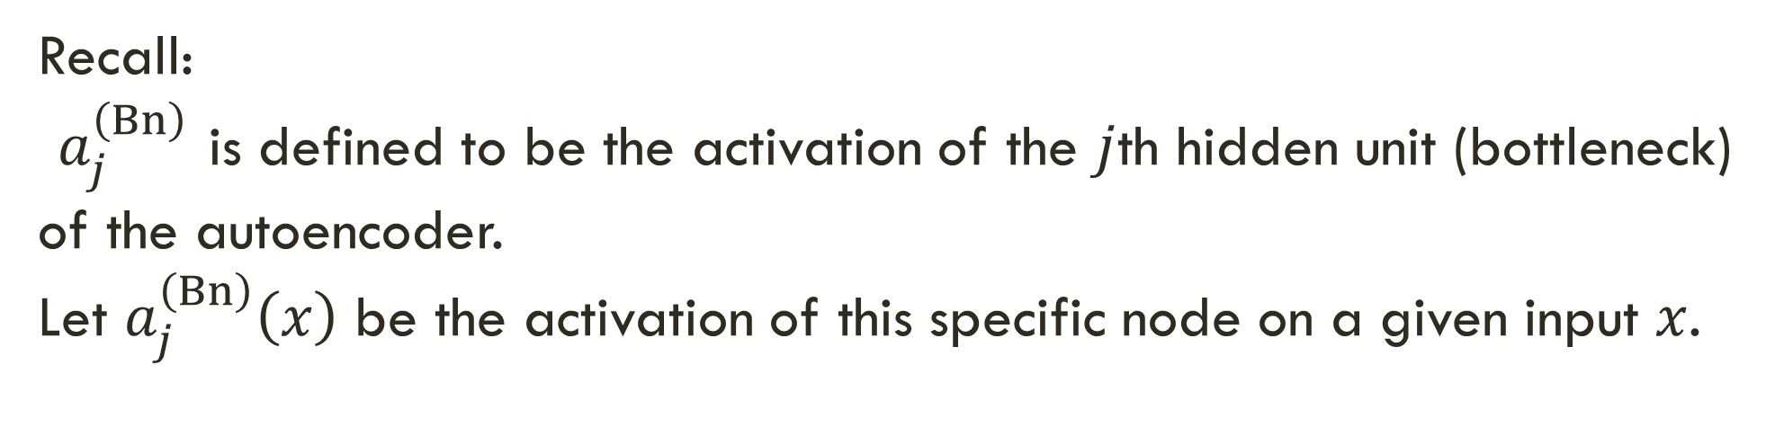
Sparsely Regulated Autoencoders
Recall:
$a_{j}^{\left(Bn\right)}$ is defined to be the activation of the $j$th hidden unit (bottleneck) of the autoencoder.
Let $a_{j}^{\left(Bn\right)}\left(x\right)$ be the activation of this specific node on a given input $x$.

Slide 34
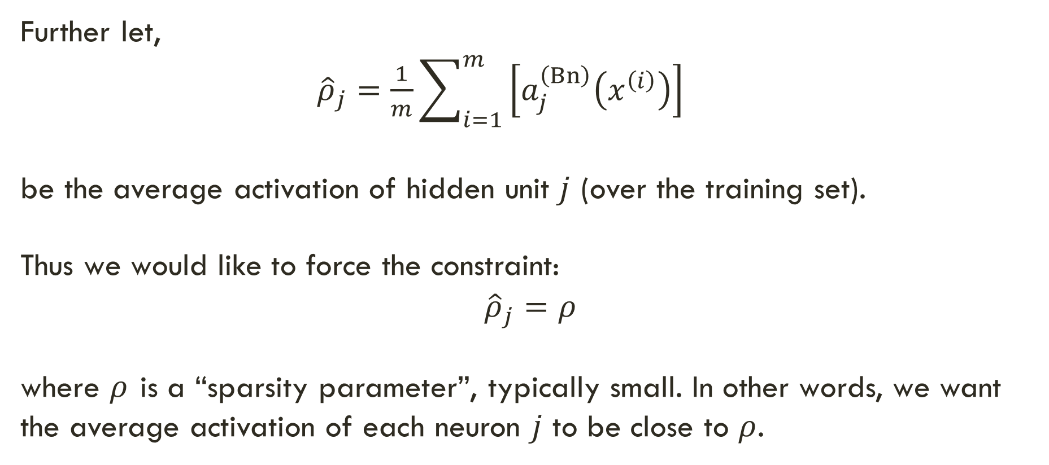
Sparsely Regulated Autoencoders
Further let,
${\hat{ρ}}_{j}=\frac{1}{m}\sum_{i=1}^{m}{\left[a_{j}^{\left(Bn\right)}\left(x^{\left(i\right)}\right)\right]}$
be the average activation of hidden unit $j$ (over the training set).
Thus we would like to force the constraint:
$${\hat{ρ}}_{j}=ρ$$
where $ρ$ is a “sparsity parameter”, typically small. In other words, we want the average activation of each neuron $j$ to be close to $ρ$.

Slide 35
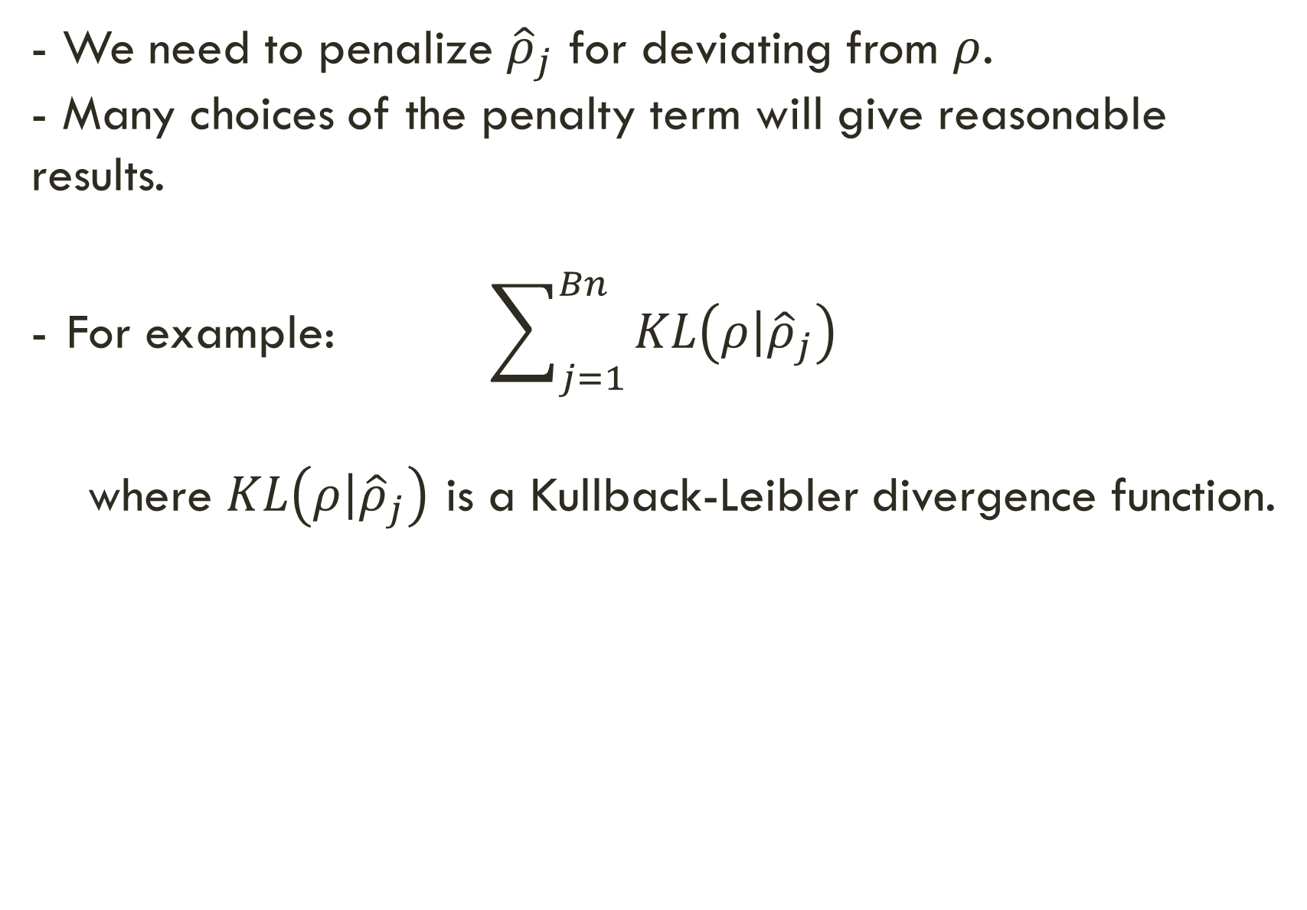
Sparsely Regulated Autoencoders
- We need to penalize ${\hat{ρ}}_{j}$ for deviating from $ρ$.
- Many choices of the penalty term will give reasonable results.
For example: $\sum_{j=1}^{Bn}{KL\left(\left.ρ\right|{\hat{ρ}}_{j}\right)}$
where $KL\left(\left.ρ\right|{\hat{ρ}}_{j}\right)$ is a Kullback-Leibler divergence function.

Slide 36
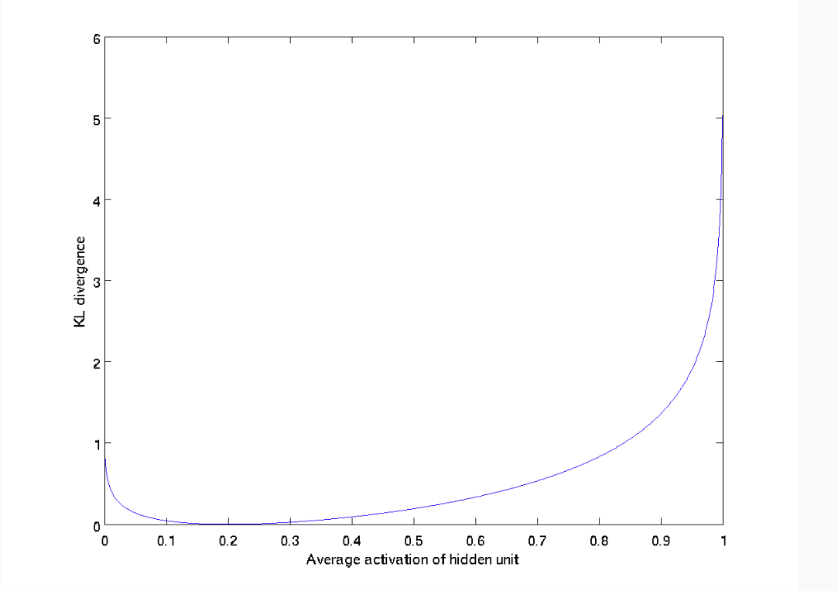
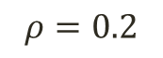
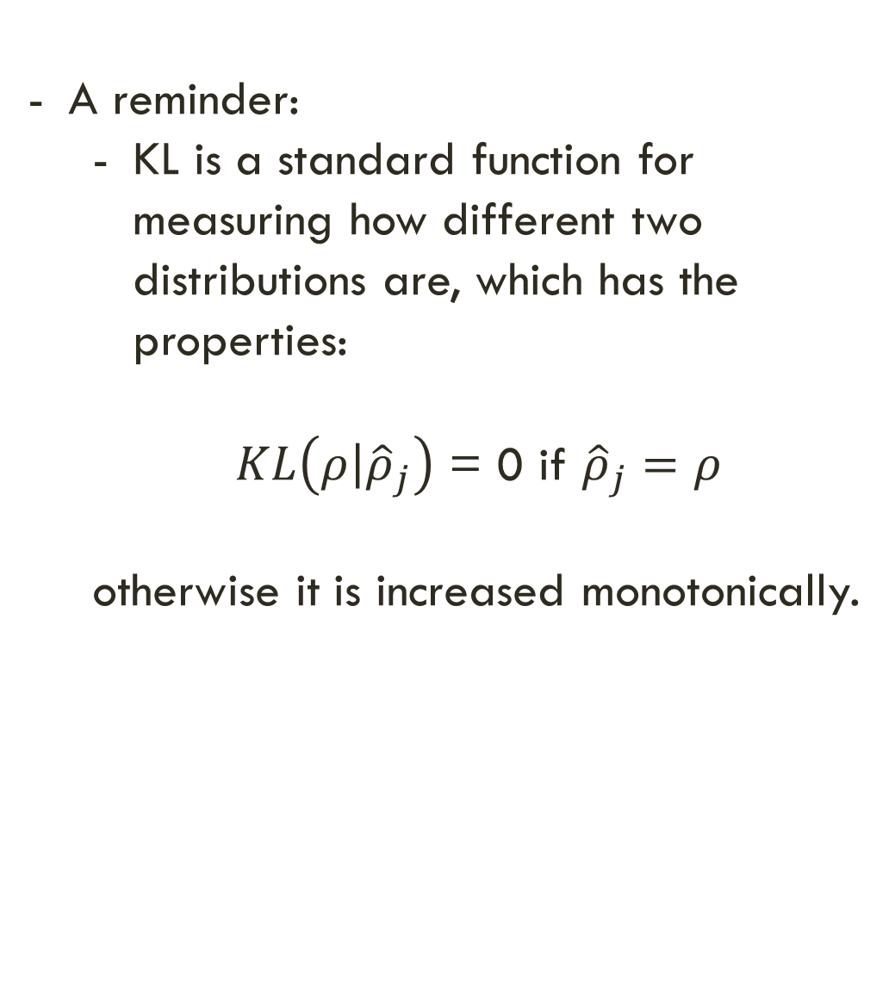
Sparsely Regulated Autoencoders
A reminder:
KL is a standard function for measuring how different two distributions are, which has the properties:
$KL\left(\left.ρ\right|{\hat{ρ}}_{j}\right)$ = 0 if ${\hat{ρ}}_{j}=ρ$
otherwise it is increased monotonically.
$$ρ=0.2$$

Slide 37
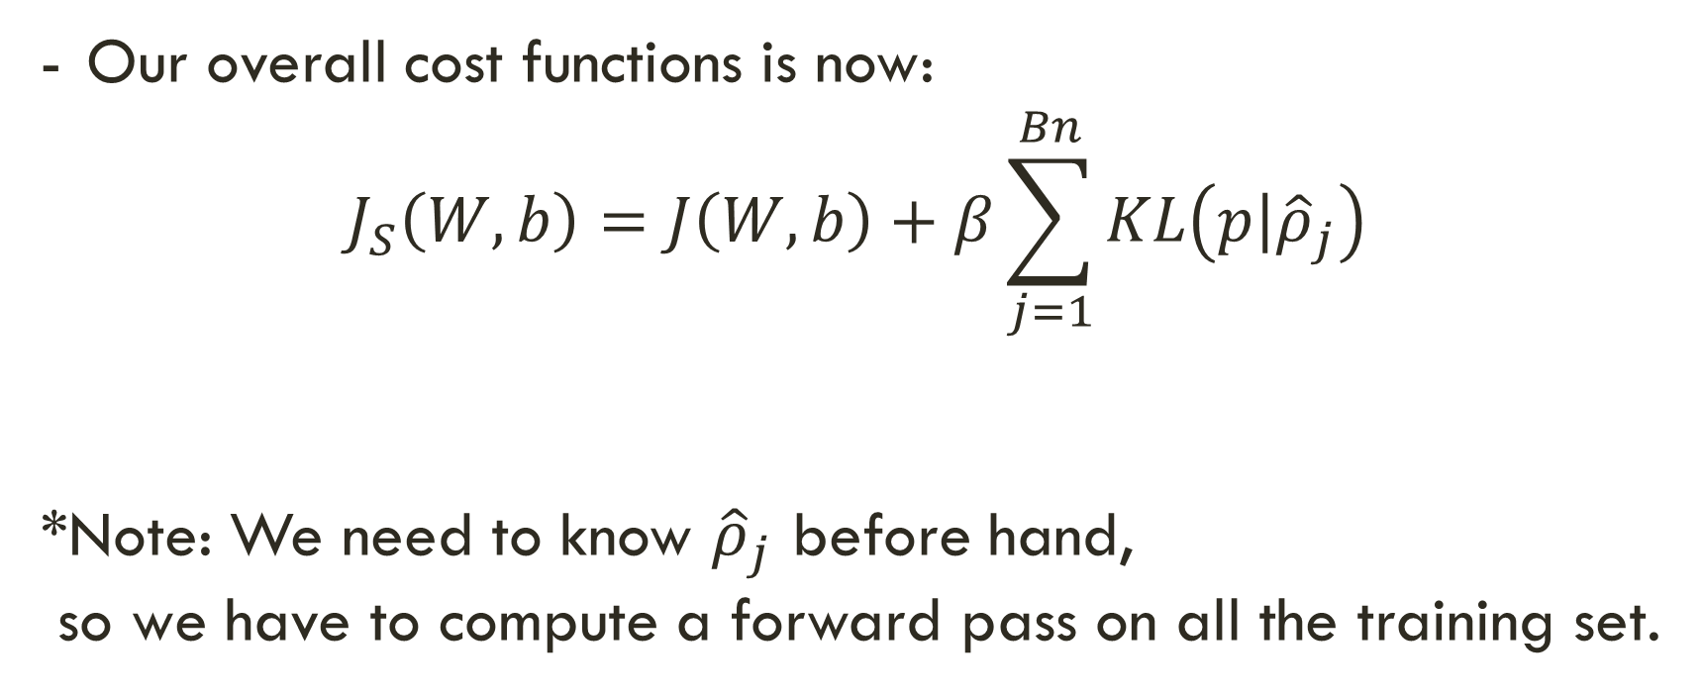
Sparsely Regulated Autoencoders
Our overall cost functions is now:
$$J_{S}\left(W,b\right)=J\left(W,b\right)+β\sum_{j=1}^{Bn}{KL\left(\left.p\right|{\hat{ρ}}_{j}\right)}$$
*Note: We need to know ${\hat{ρ}}_{j}$ before hand,
so we have to compute a forward pass on all the training set.

Slide 38


Denoising Autoencoders
Intuition:
We still aim to encode the input and to NOT mimic the identity function.
We try to undo the effect of corruption process stochastically applied to the input.
A more robust model
Encoder
Decoder
Noisy Input
Denoised Input
Latent space representation

Slide 39

Denoising Autoencoders
Use Case:
Extract robust representation for a NN classifier.
Encoder
Noisy Input
Latent space representation

Slide 40


Denoising Autoencoders
Instead of trying to mimic the identity function by minimizing:
$L\left(x,g\left(f\left(x\right)\right)\right)$
where L is some loss function
A DAE instead minimizes:
$L\left(x,g\left(f\left(\tilde{x}\right)\right)\right)$
where $\tilde{x}$ is a copy of $x$ that has been corrupted by some form of noise.

Slide 41







Denoising Autoencoders
Idea: A robust representation against noise:
Random assignment of subset of inputs to 0, with probability $v$.
Gaussian additive noise.
$$\hat{x}$$
$$w′$$
$$f\left(x\right)$$
$$w$$
$$x$$

Slide 42









Denoising Autoencoders
$$\hat{x}$$
Reconstruction $\hat{x}$ computed from the corrupted input $\tilde{x}$.
Loss function compares $\hat{x}$ reconstruction with the noiseless $x$.
$$w′$$
$$f\left(\tilde{x}\right)$$
The autoencoder cannot fully trust each feature of $x$ independently so it must learn the correlations of $x$’s features.
Based on those relations we can predict a more ‘not prune to changes’ model.
We are forcing the hidden layer to learn a generalized structure of the data.
$$w$$
$$\tilde{x}$$
0
0
0
Noise Process
$$p\left(\left.\tilde{x}\right|x\right)$$
$$x$$

Slide 43




Denoising Autoencoders - process
Taken some input $x$
Apply Noise
$$\tilde{x}$$

Slide 44


Denoising Autoencoders - process
DAE
$$\tilde{x}$$
Encode And Decode
DAE
$$g\left(f\left(\tilde{x}\right)\right)$$

Slide 45



Denoising Autoencoders - process
DAE
DAE
$$g\left(f\left(\tilde{x}\right)\right)$$
$$\hat{x}$$

Slide 46


Denoising Autoencoders - process
Compare
$$x$$
$$\hat{x}$$

Slide 47

Denoising autoencoders

Slide 48
Denoising convolutional AE – keras

Slide 49

Denoising convolutional AE – keras
- 50 epochs.
- Noise factor 0.5
- 92% accuracy on validation set.

Slide 50
Stacked AE
- Motivation:
We want to harness the feature extraction quality of a AE for our advantage.
For example: we can build a deep supervised classifier where it’s input is the output of a SAE.
The benefit: our deep model’s W are not randomly initialized but are rather “smartly selected”
Also using this unsupervised technique lets us have a larger unlabeled dataset.

Slide 51
Stacked AE
- Building a SAE consists of two phases:
1. Train each AE layer one after the other.
2. Connect any classifier (SVM / FC NN layer etc.)

Slide 52


Stacked AE
SAE
Classifier
$$x$$
$$y$$

Slide 53



Stacked AE – train process
First Layer Training (AE 1)
$$x$$
$$f_{1}\left(x\right)$$
$$z_{1}$$
$$g_{1}\left(z_{1}\right)$$
$$\hat{x}$$

Slide 54





Stacked AE – train process
Second Layer Training (AE 2)
$$x$$
$$f_{1}\left(x\right)$$
$$z_{1}$$
$$f_{2}\left(z_{1}\right)$$
$$z_{2}$$
$$g_{2}\left(z_{2}\right)$$
$${\hat{z}}_{1}$$

Slide 55

Stacked AE – train process
Add any classifier
Classifier
$$x$$
$$f_{1}\left(x\right)$$
$$z_{1}$$
$$f_{2}\left(z_{1}\right)$$
$$z_{2}$$
Output

Slide 56





Contractive autoencoders
$$\hat{x}$$
- We are still trying to avoid uninteresting features.
- Here we add a regularization term $Ω\left(x\right)$ to our loss function to limit the hidden layer.
$$w′$$
$$w$$
$$x$$

Slide 57
Contractive autoencoders
$$\hat{x}$$
- Idea: We wish to extract features that only reflect variations observed in the training set. We would like to be invariant to the other variations.
- Points close to each other in the input space maintain that property in the latent space.
$$w′$$
$$w$$
$$x$$

Slide 58


Contractive autoencoders
Definitions and reminders:
- Frobenius norm (L2): ${\left\|A\right\|}_{F}=$
- Jacobian Matrix: $J_{f}\left(x\right)$ = $\frac{∂f(x)}{∂x}$ = $\left[\begin{matrix}\frac{∂f{\left(x\right)}_{1}}{∂x_{1}} & ⋯ & \frac{∂f{\left(x\right)}_{1}}{∂x_{n}} \\ ⋮ & ⋱ & ⋮ \\ \frac{∂f{\left(x\right)}_{m}}{∂x_{1}} & ⋯ & \frac{∂f\left(x\right)m}{∂x_{n}}\end{matrix}\right]$
$$\sqrt{Σ_{i,j}{\left|a_{ij}\right|}^{2}}$$

Slide 59

Contractive autoencoders
Our new loss function would be:
$L^{∗}\left(x\right)=L\left(x\right)+λΩ\left(x\right)$
where $Ω\left(x\right)={\left\|J_{f}\left(x\right)\right\|}_{F}^{2}$ or simply: $\sum_{i,j}{{\left(\frac{∂f{\left(x\right)}_{j}}{∂x_{i}}\right)}^{2}}$
and where $λ$ controls the balance of our reconstruction objective and the hidden layer “flatness”.

Slide 60

Contractive autoencoders
Our new loss function would be:
$L^{∗}\left(x\right)=L\left(x\right)+λΩ\left(x\right)$
$L\left(x\right)$ - would be an encoder that keeps good information ($λ→0$)
$Ω\left(x\right)$ - would be an encoder that throws away all information ($λ→∞$)
Combination would be an encoder that keeps only good information.

Slide 61



Contractive autoencoders
Encoder doesn’t need to be sensitive to this variation (not observed in training data)
Encoder must be sensitive to this variation to reconstruct well

Slide 62
Which autoencoder?
- DAE make the reconstruction function resist small, finite sized perturbations in input.
- CAE make the feature encoding function resist small, infinitesimal perturbations in input.
- Both denoising AE and contractive AE perform well!

Slide 63
Which autoencoder?
Advantage of DAE: simpler to implement
Requires adding one or two lines of code to regular AE.
No need to compute Jacobian of hidden layer.
Advantage of CAE: gradient is deterministic.
- might be more stable than DAE, which uses a sampled gradient.
- one less hyper-parameter to tune (noise-factor)

Slide 64
References
https://arxiv.org/pdf/1206.5538.pdf
http://www.deeplearningbook.org/contents/autoencoders.html
http://deeplearning.net/tutorial/dA.html
http://ufldl.stanford.edu/tutorial/unsupervised/Autoencoders/
http://ufldl.stanford.edu/wiki/index.php/Stacked_Autoencoders
http://www.jmlr.org/papers/volume11/vincent10a/vincent10a.pdf
https://codeburst.io/deep-learning-types-and-autoencoders-a40ee6754663

